Slide 1

What is technical
communication?
Notes:
Technical: Greek, “technic” pertaining to skill or art
Communication: Latin, to impart; to make common to many (sharing information, making that knowledge common)
Source: The OED

Slide 2
Workplace communication
2. A genre of writing
Notes:
Workplace communication: presentations, emails, job market materials, phone calls with clients
Textbooks, owner’s manuals, proposals, reports

Slide 3

Audience
+
Purpose
Notes:
Audience: peers and supervisors, clients
Purpose: reinforce or change attitudes, motivate them to take action, help them carry out their jobs
Image example: Directions for a building: better be correct!
Example: you’re a public-health scientist and have discovered an ingredient that has helped prevent coronary heart disease; you report your methods and findings; that report helps other scientists follow up on your study to discover how to link longevity with that ingredient

Slide 4

Address Particular Readers
Notes:
Think about writing a proposal for your supervisor: consider their job responsibilities, the level of detail they’d like to see, any personal factors VS. how this might change if you are writing to a client (consider what stakes the project holds for each reader, what they want to see, etc.)

Slide 5
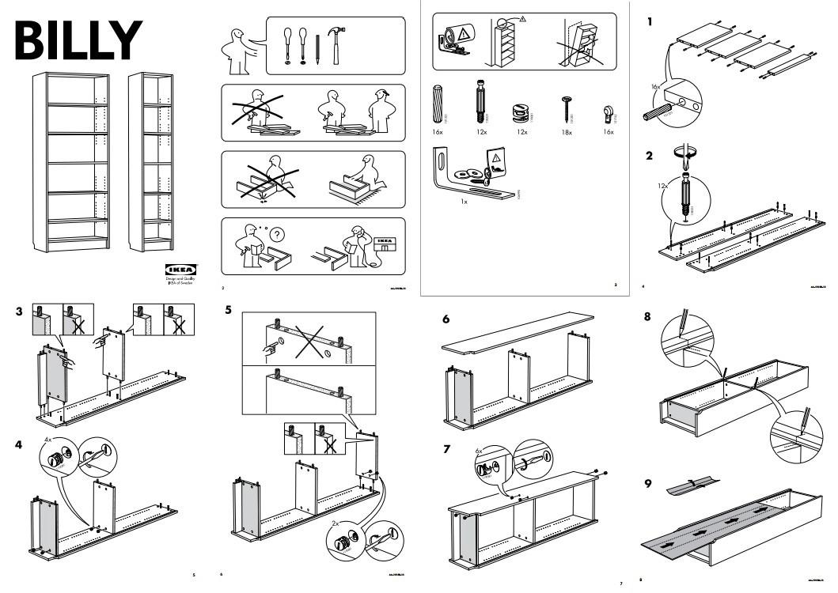
Notes:
Why does IKEA not include text directions?
How else have they formatted this page to increase readability?

Slide 6
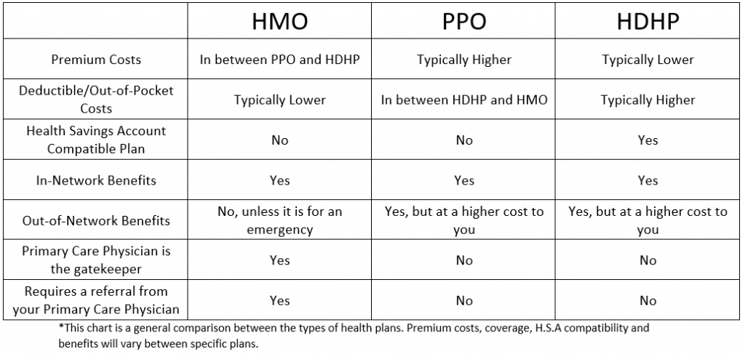
Helps readers solve problems
Notes:
Technical documents help readers learn something new or carry out a task. For instance, this document indicates the pros and cons to three options for health insurance. This helps the reader decide the best option for them.

Slide 7

Reflects an organization’s goals and culture
Notes:
Consider how this flyer reflects the goals and culture of Kent State Podiatric Medicine
--color, images used, the text/data represented
Consider audience and purpose! Who is this flyer meant for? What is it trying to achieve?

Slide 8
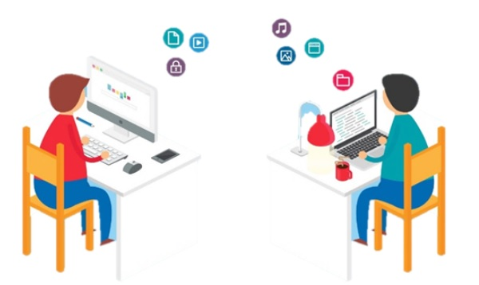
Is produced collaboratively
Notes:
Collaboration is common in technical communication because no ONE person has all the information, skills, or time to create accurate, detailed, and sometimes large documents. Some people are subject-matter experts while others might be production specialists, so working together creates the best documents.
However….working in groups often strikes fear (disgust, hatred) in students….but the reality is that engineering demands that folks work together.
Think about what tools or techniques have worked for you to make working together (writing, or creating presentations) a good experience.

Slide 9

Uses design to
increase readability
Notes:
Typography, spacing, color, headers, numbers, etc.
Make the document look professional
Help the reader navigate the document--help readers find particular sections
Help readers understand the document--safety warnings in a text different from the rest, for example

Slide 10
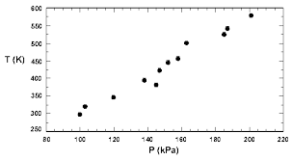
Consists of words or graphics or both
Notes:
Graphics (images, charts, figures) help make the document interesting and help the reader communicate:
Difficult concepts
Instructions or processes
Quantifiable data
With nonnative speakers

Slide 11

Notes:
Image source: https://mymodernmet.com/30-cool-infographics/

Slide 12
Technical Communication
Honesty
Accessibility
Clarity
Accuracy
Professional Appearance
Comprehensiveness
Correctness
Conciseness
Notes:
Honesty: most important; ethical, readers could get hurt, organization could face charges
Clarity: easily understood; unclear documents can be dangerous, could cause expensive mistakes
Accuracy: Get facts straight, no inaccuracies; be unbiased
Comprehensiveness: Provide all the information that is needed: provide background and sufficient details
Accessibility: Consider small, independent sections because people probably will not read from start to end
Conciseness: Needs to be useful to busy readers; use short words, eliminate unnecessary phrases
Professional Appearance: Your document communicates before readers even engage with the text
Correctness: Grammar, punctuation, spelling; eliminate errors

